Slide 1
Lab2

Slide 2
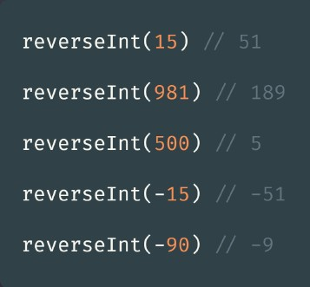
Lab1
Given an integer n, return an integer that is the reverse ordering of digits.

Slide 3
Lab2
Theatre Square in the capital city of Berland has a rectangular shape with the size n × m meters. On the occasion of the city's anniversary, a decision was taken to pave the Square with square granite flagstones. Each flagstone is of the size a × a.
What is the least number of flagstones needed to pave the Square? It's allowed to cover the surface larger than the Theatre Square, but the Square has to be covered. It's not allowed to break the flagstones. The sides of flagstones should be parallel to the sides of the Square.
Input
The input contains three positive integer numbers in the first line: n, m and a (1 ≤ n, m, a ≤ 10⁹).
Output
Write the needed number of flagstones.

Slide 4
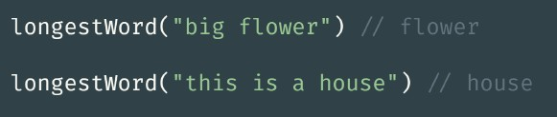
Lab3
Given a string implement a function which returns longest word in that string. If there are two or more words that have the same length, return the first longest word from the string. Ignore punctuation. Input string can't be empty or blank string.

Slide 5


Lab4

